Slide 1



Teaser for Investiment Villas Real Pontal
Mangue Seco Complex

Slide 2

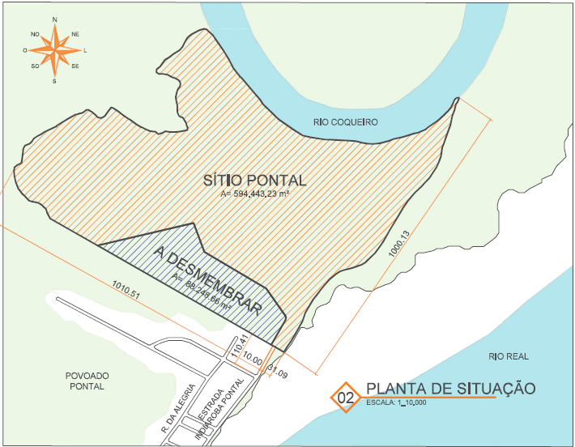
The Plot
600,000 m² of buildable area
Access to the Coqueiro River and Mangue Seco delta and sand strip
Capacity to build up to 5 sectors for various purposes
Environmental licenses obtained to implement various projects

Slide 3
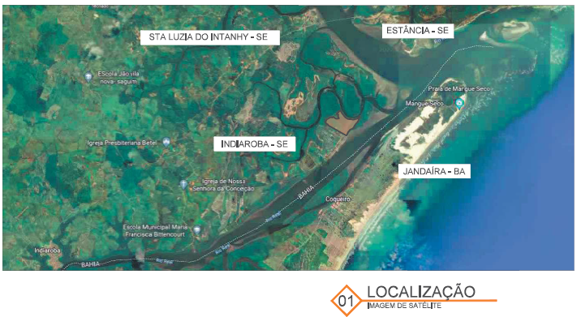
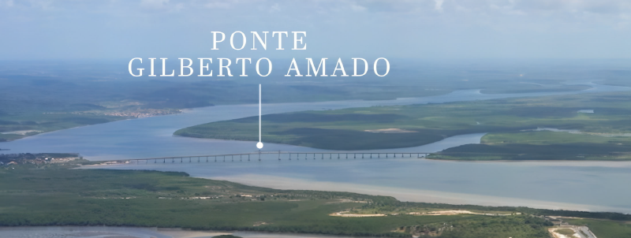
The Location
Indiaroba - SE
Easy access through the Linha Verde (BA-099) and the Gilberto Amado Bridge
Less than 2 hours from the main beaches on the north coast of Bahia (Praia do Forte, Imbassaí and Costa do Sauípe)
88km from Aracaju Airport
220km from Salvador Airport

Slide 4
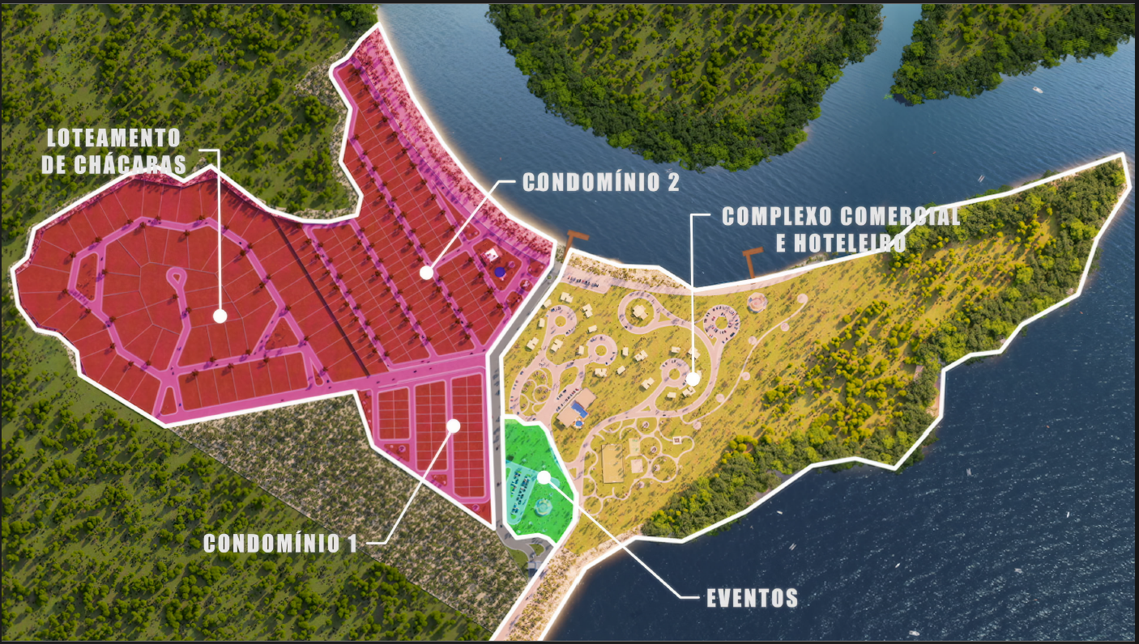
Project Option
Events Area - 17,551 m²
Commercial and Hotel Complex - 183,679 m²
Condominium 1 - 36,443 m² (54 plots)
Condominium 2 - 161,770 m² (151 plots)
Villas - 165,565 m² (60 plots)

Slide 5
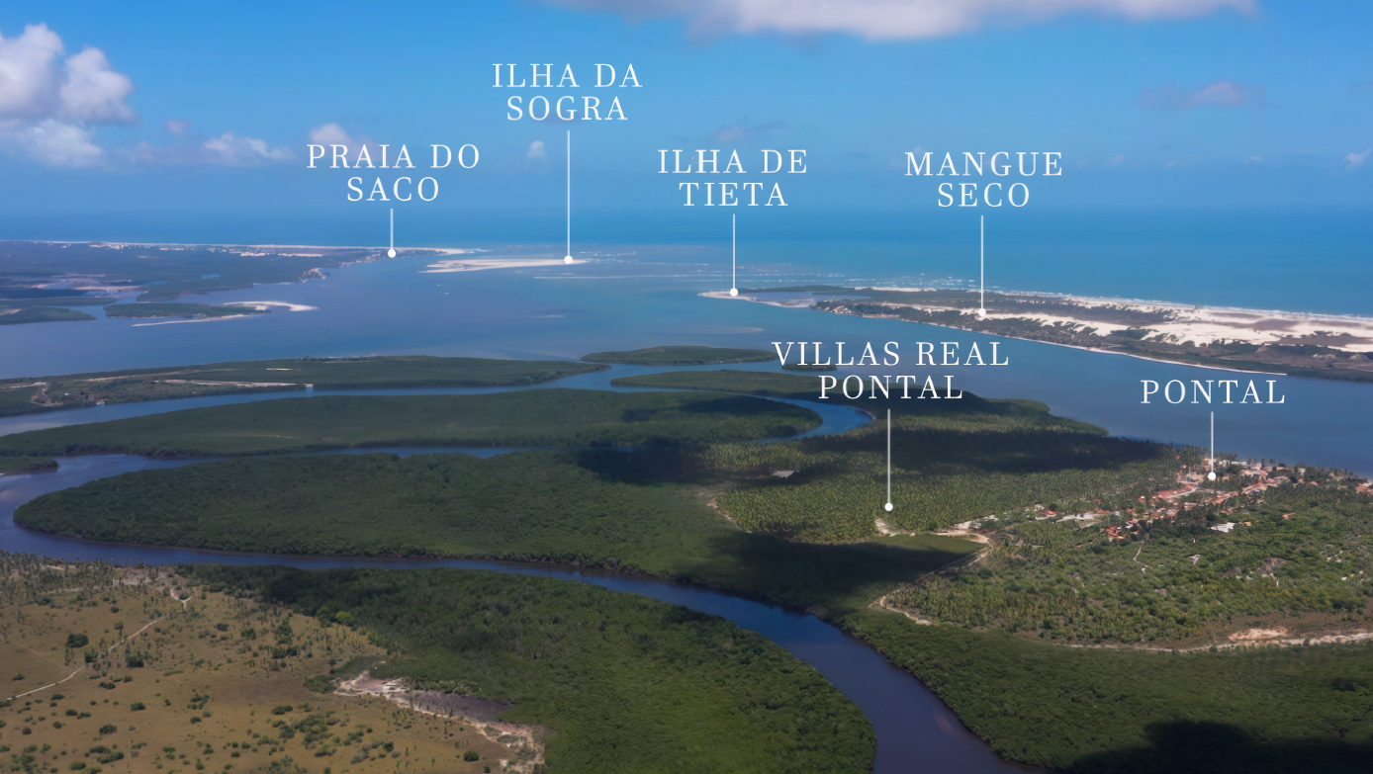
Ecoturism
Bordered by the Coqueiro and Real Rivers and with direct access to the sea through the Mangue Seco / BA delta, Villas Real Pontal offers water leisure and ecotourism.
Access to Mangue Seco / BA directly through the Rio Real. The region has 30 km of beaches, as well as incredible dunes and diverse scenery with views of the sea.

Slide 6
Villas Real Pontal
Português
https://youtu.be/8cTiZN0YHm0
English
https://youtu.be/ipLfqU75zE8

Slide 7
Pontal & Region in the Media
Acelera Sergipe plans to invest in the redevelopment of the Povoado Pontal waterfront, a strategic project to attract major investments such as restaurants, bars and accommodation in the tourist region
Implementation of Sergipe's largest Beach Club on Mosqueiro Beach in Aracaju. 1h20 from the site.
Business group announces BRL 300 million investment in hotel development on Mosqueiro Beach in Aracaju.

Slide 8
Pontal & Region in the Media
Public Security shows record reductions in homicides and robberies in Sergipe. Among neighboring states, Sergipe has the best security.
Medium and high standard condominiums are springing up in the Mangue Seco Complex (Pontal Eco Residence, Maldivas Baianas, Estações Hoteleira with Multiproperty). Porto Belo Condominium with 500K plots and 1.5 Mi houses.
Executives from Green Energy Park, one of the largest vertically integrated renewable energy companies, visited the governor of Sergipe, Fábio Mitidieri, and presented investment possibilities in the state.

Slide 9
Public Sources
https://www.se.gov.br/noticias/desenvolvimento/governo_de_sergipe_lanca_programa_inedito_de_investimentos_estruturantes_para_alavancar_o_desenvolvimento_regional
https://www.capitaldoagreste.com.br/implantacao-do-maior-beach-club-de-sergipe-sera-iniciada-no-mes-de-novembro/
https://www.se.gov.br/noticias/governo/grupo_empresarial_anuncia_investimentos_de_r_300_milhoes_na_construcao_de_empreendimento_hoteleiro_em_sergipe
https://www.se.gov.br/noticias/governo/seguranca_publica_apresenta_reducoes_de_homicidios_e_latrocinios_de_serie_historica_registrada_em_sergipe
https://pontualurbanizadora.com.br/ & https://www.maimob.com.br/lancamentos/belleville-litoral-sul-12
https://revistanordeste.com.br/sergipe-na-pauta-da-green-energy-park-para-futuras-parcerias/

Slide 10

Contact us
Anizio Torres
  +55 79 98807-6000
  aniziotorres@gmail.com
Ildo Torres
  +55 79 99917-7473

